Slide 1
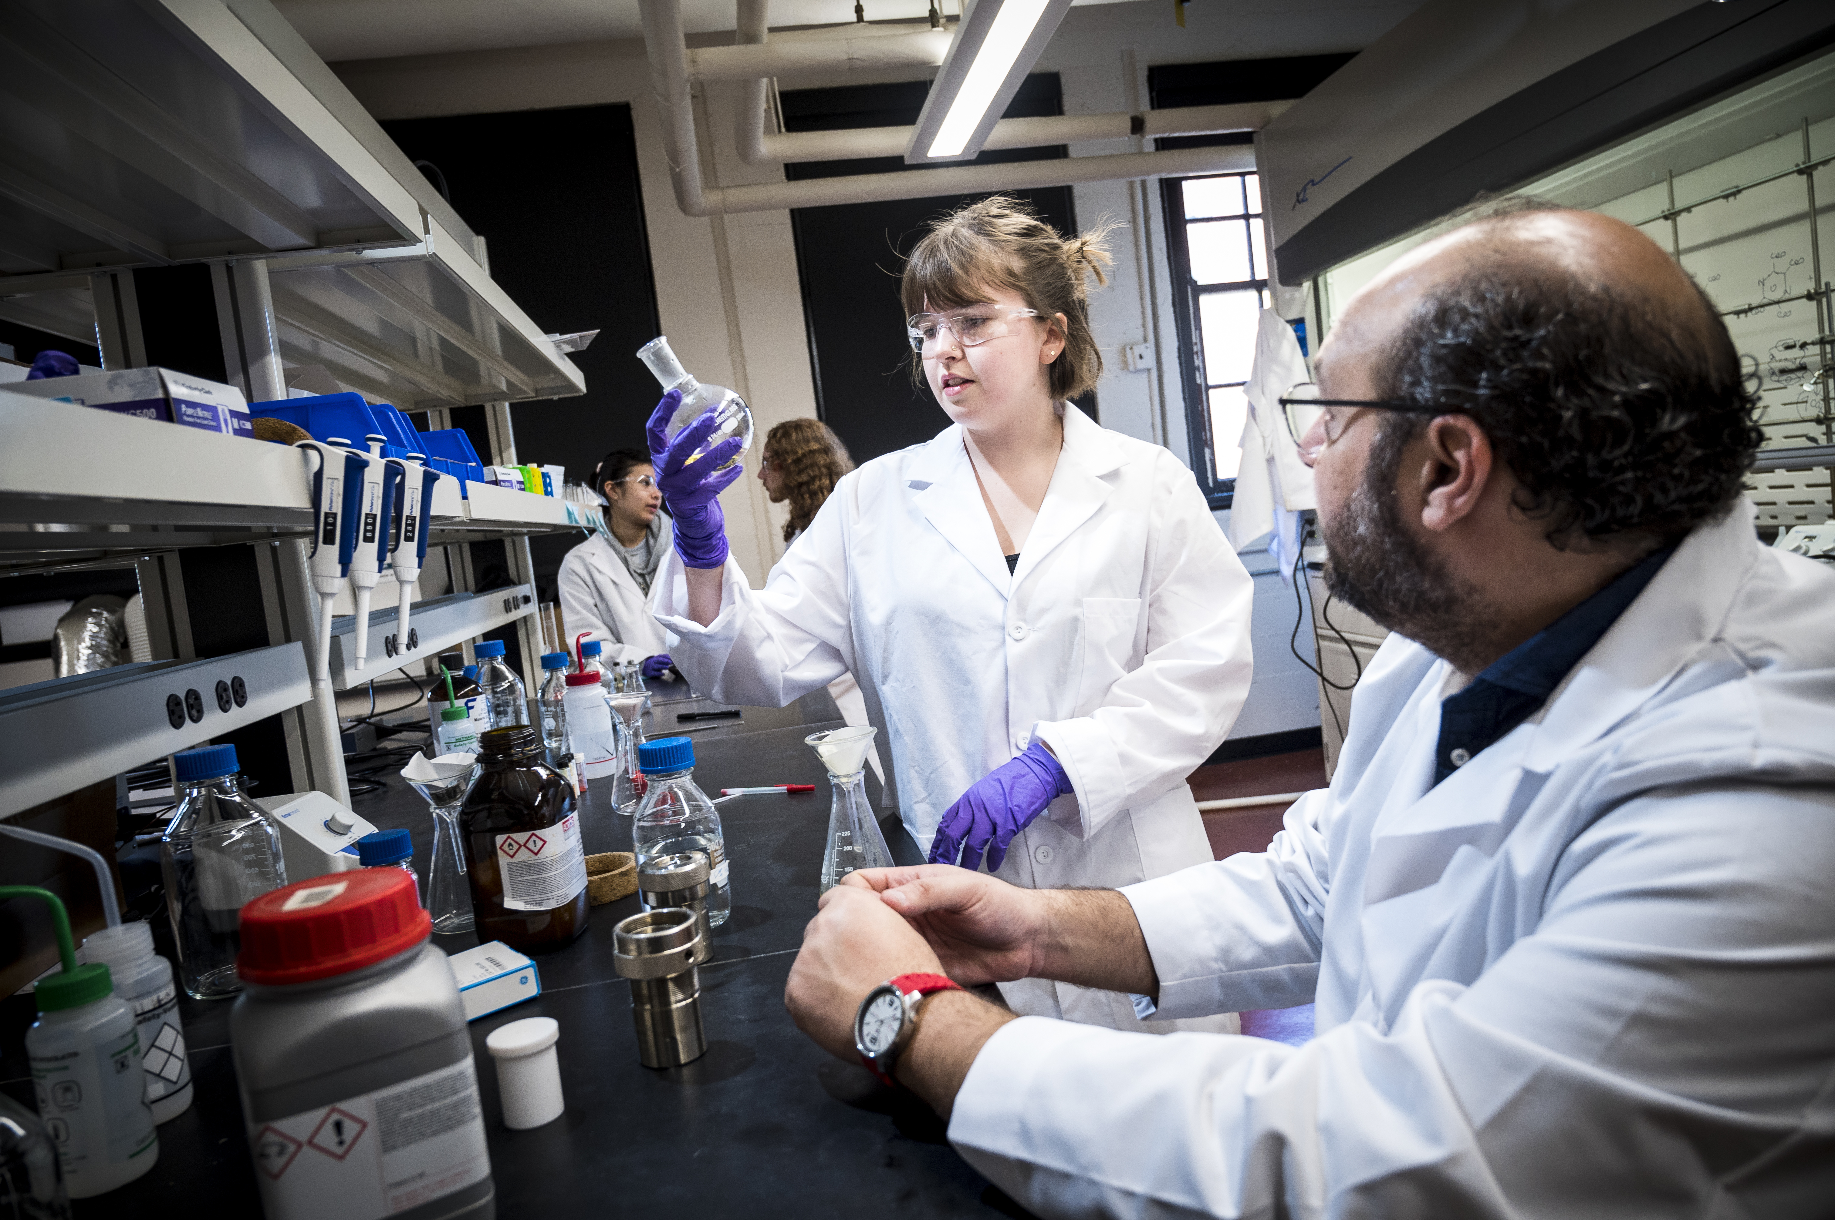

Mentored Employment Program Example Projects
Notes:
Must be in Slide Master mode to swap out photos.

Slide 2
Ideal Projects for the Mentored Employment Program
Research Assistance (lab or field)
Teaching or Educational
Programmatic (develop new programs for a unit/entity/research group)
Project-based (specific set of assignments for overall team project)

Slide 3
Effect of coatings on performance of various wood products
Description of project or research opportunity: Architects are increasingly interested in using wood in various outdoor exposures. These exposures increase the risk of wetting and subsequent physical or biological degradation. Various coatings have been proposed for protecting these materials, but performance data are lacking. The goal of this project is to apply coating sot various wood-based materials (Douglas-fir, red alder, ponderosa pine, acetylated wood, and others) and assess these materials after varying periods of outdoor exposure.
Tasks student will perform: The student will help apply coatings (the materials have already been prepared), collect scanning data on initial appearance and then scan materials after varying periods of outdoor exposure. The student will also learn how to process color image data and learn other coating assessment techniques (visual assessment, coating adherence, etc.)

Slide 4
Riparian restoration – stand dynamics in middle-aged projects
Description of project or research opportunity: Millions of dollars are spent annually to restore riparian areas, often in lands previously used for pasture and agriculture. The ecosystem benefits from these projects typically take decades to achieve, while most monitoring and evaluation ends once the plantings are "free-to-grow." This project is based on permanent plots established in riparian restoration in the early 2000s where the plantings are now approximately 15 year of age. Plot re-measurements are providing data on the growth, survival, competition, and stand conditions for these middle-aged plantings. The results of this research will be used to better design and evaluate riparian restoration projects and programs.
Tasks student will perform: Transfer data from field sheets to MS-Excel spreadsheets; organize and annotate photos taken during monitoring. Conduct QA/QC for the field data; prepare descriptive statistics and summarize data. Prepare graphics for PowerPoint presentations. Participate in field work including restoration activities (site-preparation; planting; establishing monitoring plots).

Slide 5
Western Oregon beaver monitoring project
Description of project or research opportunity: This position supports multiple ongoing and novel wildlife studies conducted in collaboration with the USDA National Wildlife Research Center, Corvallis Field Station. Our research integrates forest and wildlife management to resolve human-wildlife conflicts related to forestry. The successful candidate is expected to assist with American beaver activity surveys and hydrological based data collection of dam impoundments throughout western Oregon. Habitat sampling, in addition to data compilation into standardized electronic formats will also be expected.
Most job duties will be conducted outdoors in arduous conditions including streams, steep terrain, inclement weather, and dense vegetation. Data entry will be conducted in an office environment. Due to travel and sampling logistics, most field work hours will be conducted in 1-2 full days each week.
Tasks student will perform: Recognize and interpret American beaver activity throughout stream reaches; Deploy water temperature monitoring equipment (thermistors) at dam sites; Record dissolved oxygen levels at dam sites; Sample vegetative and geomorphic habitat characteristics at study reaches; Data entry of field collected measurements.

Slide 6
Managing black stain root disease in pacific northwest tree farms
Description of project or research opportunity: The primary focus of this opportunity is to study Leptographium wageneri, the causal organism of Black Stain Root Disease (BSRD) within and between young Douglas-fir plantations in western Oregon and Washington in order to reduce the damage caused by this disease. The successful applicant will work with a diverse group of faculty, graduate students, and research assistants to study this disease which threatens Oregon’s forests. Duties will include collection of field samples from several forest types, followed by identification of organisms using a variety of laboratory and greenhouse techniques. The candidate will be responsible for a small research project examining the biology of aBlack Stain Root Disease of Douglas-fir it the Pacific Northwest. Candidates interested in the health of Oregon forests and a career in forest pathology are strongly encouraged to apply.
Tasks student will perform: Collecting field samples of water, soil, and infected plants in order to determine what organisms are causing particular symptoms and diseases. (Duties include field collections, DNA extraction, gel electrophoresis, fungal baiting, and isolation). In addition, the student will help graduate students in the forest pathology research program prepare and conduct greenhouse experiments (duties include growing fungi, conducting inoculations, potting, fertilization, and watering of trees).

Slide 7
Backcountry camping management in Yosemite National Park Wilderness
Description of project or research opportunity: Yosemite National Park is in the process of updating its Wilderness permit system. As part of this project, visitors completed travel diaries during the Spring, Summer, and Fall of 2021. These diaries included questions about Wilderness character and participatory mapping of where visitors camped each night of their trip. These travel diaries will be used in a model to determine the permit numbers per camping zone in Yosemite National Park. We are also interested in understanding if different Yosemite National Park Wilderness visitor groups (etc. PCT thru-hikers, JMT hikers) respond to survey questions about Wilderness character and/or behave differently when camping.
Tasks student will perform: This project has two parts, the first involved entering the travel diary survey results into Excel. These results will be summarized in SPSS (or another similar program such as R). The student will generate summary tables and figures from the survey results. The second part involves digitizing in GIS the locations where visitors camped in Yosemite and connecting these camping locations to the survey results from part one. The student will generate spatial and temporal summaries of the zones where visitors camped and create maps of camping locations by zones.

Slide 8
Hydrology Field Technician
Description of project or research opportunity: Undergraduate students that want build foundational research skills in the realm of hydrology or forestry would benefit from this opportunity. The Watershed Processes Lab is a diverse and multidisciplinary research group that trains and deploys students assist in various research efforts that inform us on forest health and function. Many of the students I have mentored through this program have continued to work in my lab specially during the summer season.
Tasks student will perform: The student will have opportunities to learn about: Installation of instrumentation, downloading data from instrumentation installed to monitor meteorological and hydrologic conditions, streamflow gauging using different methods, water sample collection, topographic surveying, operation and deployment of automatic (ISCO) water samplers, use of a multiparameter water quality sonde, use of a water stable isotope analyzer.

Slide 9
Laminated Bamboo Lumber Testing
Description of project or research opportunity: Bamboo composites are being seen as sustainable building materials for use in green building applications. Laminated bamboo lumber are similar in size and form as dimension lumber. For certain properties, LBL perform better than lumber of similar dimension. One such property is compression parallel to grain. The failure mode, however, are contrastingly different with individual slats in the LBL buckling across the wide face. This is counterintuitive. It is hypothesized that anatomy of bamboo at the nodes influence this behavior. The project will test this hypothesis by testing several LBL configurations in compression and characterizing the buckling behavior.
Tasks student will perform: This project requires hands-on work in the laboratory to prepare samples and test bamboo compression samples to evaluate its buckling characteristics. The undergraduate research assistant will work with me and a faculty research assistant on this project. The student will have a lot of interactions with other graduate students during this project. The student would also work with a bamboo products company out of Portland to collect different bamboo structural products. The main tasks will be - procuring material, preparing samples, arranging test set up, testing of materials, data collection, data collection, data analysis, and reporting.

Slide 10
Who can be a Mentor
College of Forestry Faculty
Extension Faculty
Post-doctoral researchers
Faculty research assistants

Slide 11
“Mentor”
“ An experienced and trusted advisor”
“To provide guidance, advice, feedback and support the mentee”
https://eller.arizona.edu/news/2022/06/11-roles-responsibilities-you-build-better-mentor-mentee-relationship#:~:text=Some%20of%20the%20responsibilities%20of,a%20better%20version%20of%20themselves.

